Slide 1

Injury Severity Prediction using Crash Data report, Tempe City
Presented By:
Dixith Kumar Bandari

Slide 2
Introduction
Traffic accidents cause widespread human suffering and economic loss; predicting injury severity remains a complex challenge.
Understanding factors behind injury severity is vital for effective emergency response and road safety improvement.
Utilizes machine learning to analyze historical traffic accident data, focusing on factors affecting the injury severity.
Aims to deepen understanding of traffic injury dynamics and support informed decision-making in traffic safety management.

Slide 3
Objectives
The main goal of the project is to use the information included in this dataset to forecast the possibility of injuries coming from various accidents.
We want to find trends and connections that shed light on the dynamics of high-severity traffic events in Tempe by carefully examining the historical records.
We want to provide useful insights for preventative safety actions with this predictive study.
Flourish traffic safety measure based up the results generated by the Machine Learning algorithms.

Slide 4
Dataset Overview
Data source:
https://catalog.data.gov/dataset/1-08-crash-data-report-detail-498c3
Tempe offers a singular chance for data-driven research in the field of traffic safety, where the difference between accidents and avoidable events is critical.
This is an enormous dataset that Tempe city gave, which includes information on collisions between cars, bicycles, and pedestrians.
The dataset classifies these occurrences according to severity, with an emphasis on fatal and serious injuries, in addition to defining the kind and location of these incidents.

Slide 5
Columns Description
X, Y (Latitude, Longitude): These columns represent the geographical coordinates of the crash site.
OBJECTID, IncidentId: Unique identifiers for each crash incident.
DateTime: The date and time when the crash occurred.
Year: The year of the crash.
StreetName, CrossStreet: Names of the streets where the crash occurred.
Distance: The distance related to the junction or reference point.
JunctionRelation: Describes the relation of the crash to a junction.
Totalinjuries, Totalfatalities: Counts of injuries and fatalities in the crash.
Injuryseverity: The severity level of injuries sustained.

Slide 6
Collisionmanner: How the collision occurred (e.g., rear-end, side-swipe).
Lightcondition: The light conditions at the time of the crash (e.g., daylight, dark).
Weather, SurfaceCondition: Weather conditions and state of the road surface at the time of the crash.
Unittype_One, Unittype_Two: Types of units involved in the crash (e.g., vehicle, bicycle).
Age_Drv1, Age_Drv2: Ages of the drivers involved.
Gender_Drv1, Gender_Drv2: Genders of the drivers.
Traveldirection_One, Traveldirection_Two: Travel directions of the units involved.
Unitaction_One, Unitaction_Two: Actions of the units at the time of the crash.
Violation1_Drv1, Violation1_Drv2: Any traffic violations by the drivers.
AlcoholUse_Drv1, AlcoholUse_Drv2, DrugUse_Drv1, DrugUse_Drv2: Indicators of alcohol or drug use by the drivers.

Slide 7
Data Preprocessing
Initially, the dataset contains 47,741 rows, 35 columns in total.
The rows containing “Null” values were deleted to make the dataset robust, the dataset has 43,283 rows without null values.
Data redundancy is performed to remove 11,173 duplicate rows from the dataset having the same values.
The dataset has a total of 32,110 rows after removing null values and duplicate rows.

Slide 8
Target Variable and Features selection
The Target variable to host the predictive analysis on injuries severity is “Injury severity”.
Amongst the 35 variables, most relevant variables to predict the injury impact based on available data and characteristics are: Totalinjuries, Age_Drv1, Age_Drv2, Collisionmanner, Weather, Lightcondition, SurfaceCondition, AlcoholUse_Drv1, AlcoholUse_Drv2, DrugUse_Drv1, DrugUse_Drv2.

Slide 9
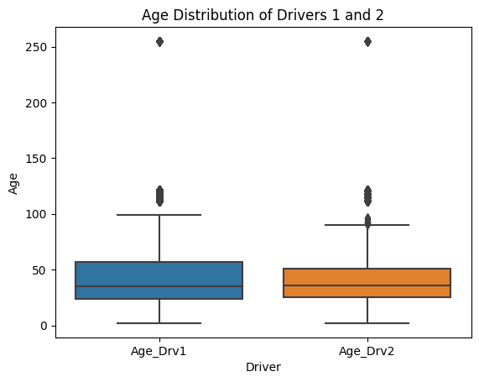
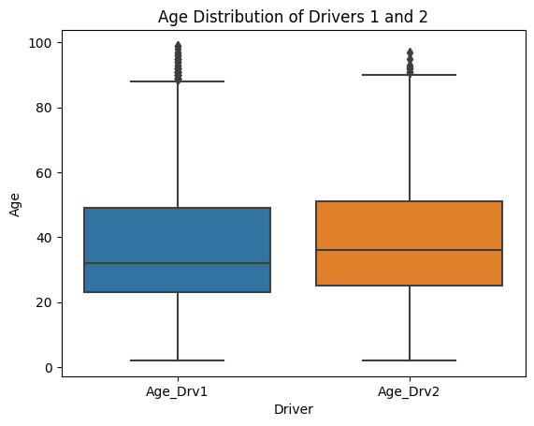
Exploratory Data Analysis

Slide 10
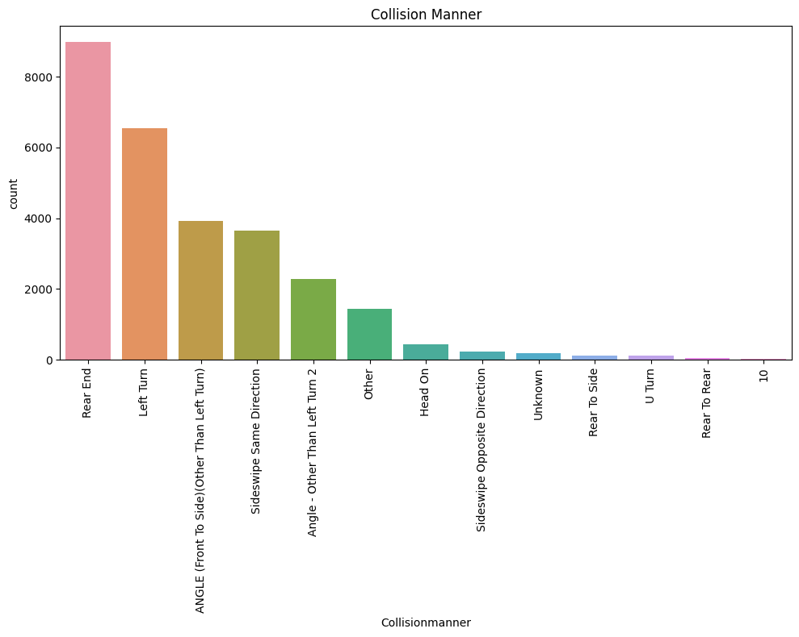
'Rear End' collisions are the predominant cause of traffic accidents, with the highest count on the graph.
The following most common accident types are 'Left Turn', 'Angle', and 'Sideswipe Same Direction'.
Collisions during 'U-Turn' and 'Backing' are relatively rare in comparison.

Slide 11
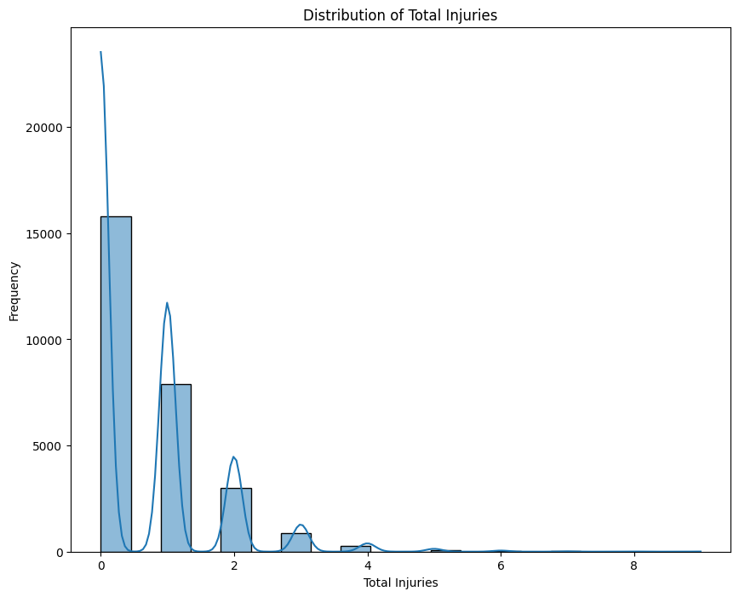
Accidents resulting in no injuries are the most frequent, while those with one injury follow but with a significantly lower frequency.
Incidents causing more than three injuries are rare, showing a steep decline in frequency on the graph.

Slide 12
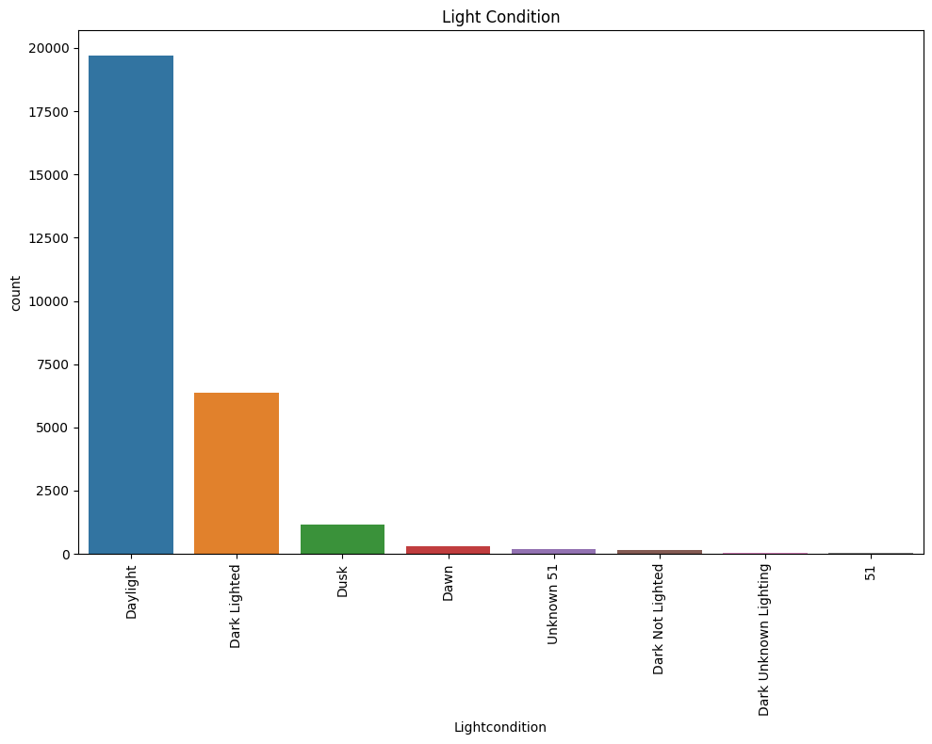
Most traffic accidents occur in daylight, with the count significantly higher than in any other light condition.
Dusk and dark-lighted conditions are next in frequency, indicating a lower but notable number of accidents during these times.
Accidents in dawn or dark conditions with street lights are relatively infrequent, and those in unknown or other specified lighting are minimal.

Slide 13
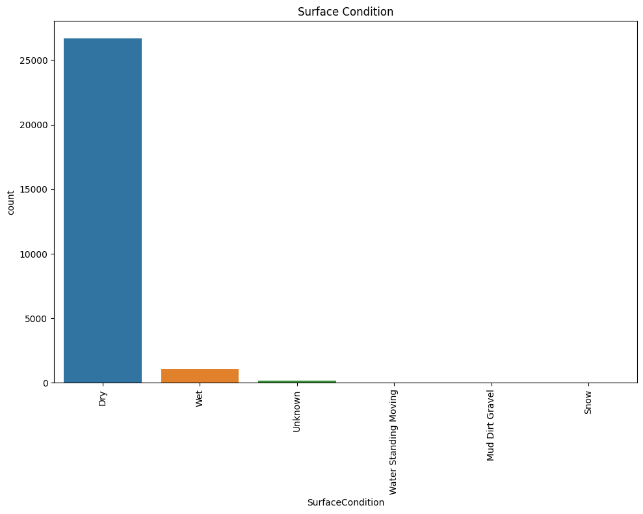
The majority of traffic accidents occur on dry road surface conditions, as shown by the significant count difference.
Wet surface conditions are the second most common, but with a considerably lower count than dry conditions.
Other surface conditions like snow, ice, and water (standing/moving) contribute to a relatively small number of accidents.

Slide 14
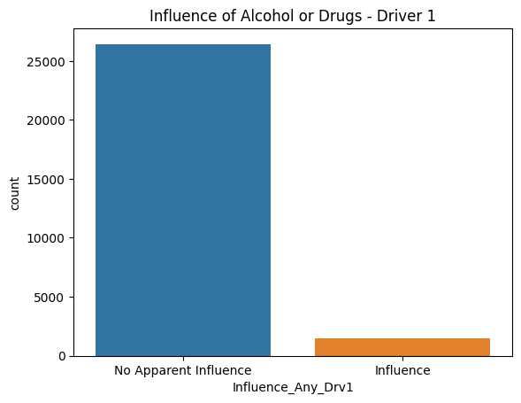
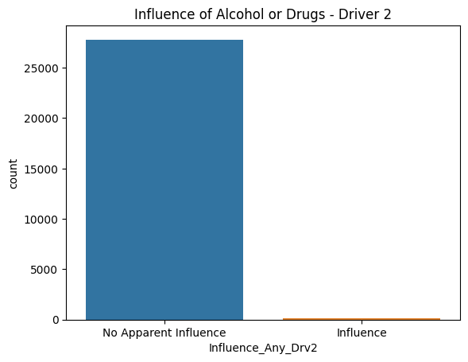

Slide 15
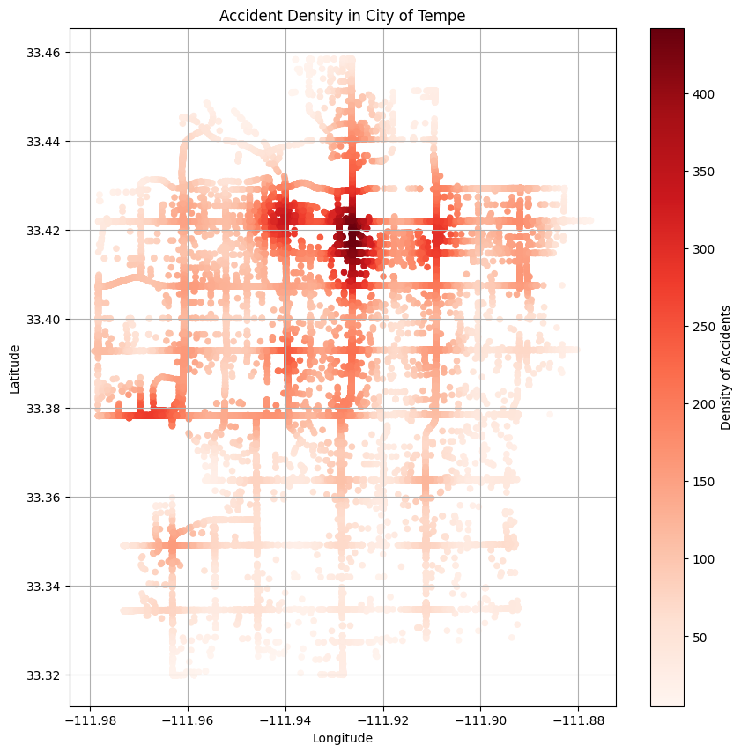
The heatmap indicates a high density of accidents concentrated in specific areas of Tempe, with the most intense areas shown in dark red.
There is a noticeable spread of accidents across the city, but with clear hotspots that suggest higher risk zones.
The latitude and longitude coordinates suggest that the central regions of the city experience a higher frequency of traffic accidents.

Slide 16
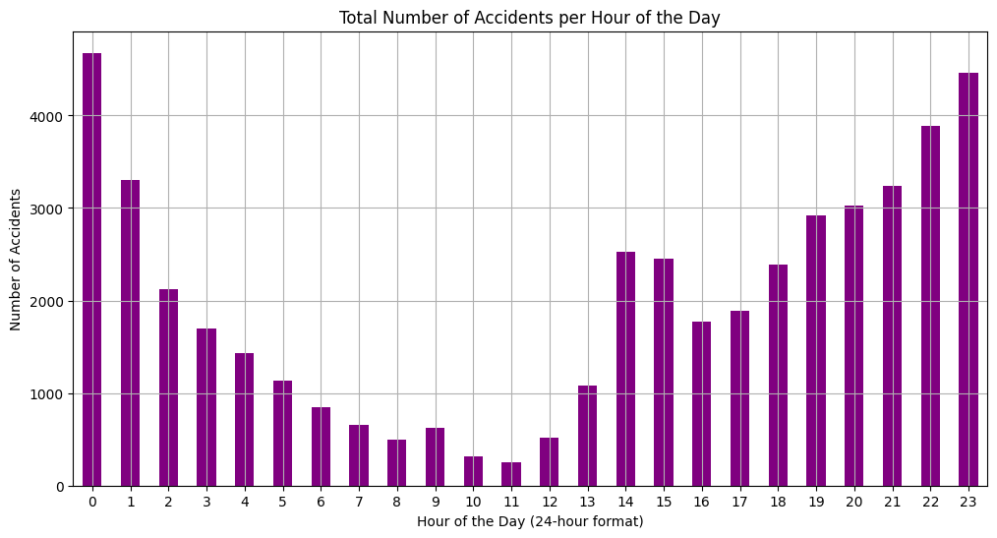
Accident frequency peaks around 12 AM and late night hours (from 8 PM).
There is a notable dip in accidents during the usual overnight hours (from 3 AM to 5 AM) and mid-day (from 10 AM to 11 AM).
Afternoon hours also show an increased number of accidents, with another peak occurring around 2 PM.

Slide 17
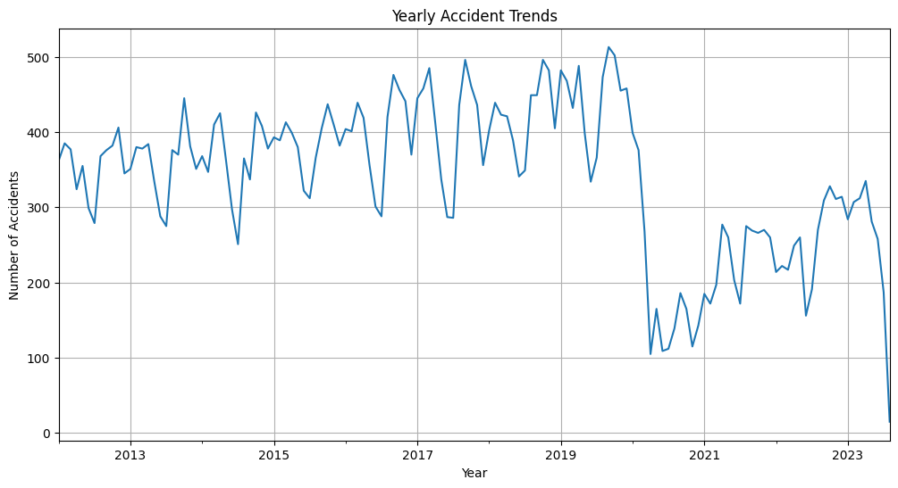
The trend shows fluctuating accident numbers per year with peaks around 2019 and a notable decline starting in 2020.
There's a general increase in accidents from 2013 to 2019, followed by a period of variability until a downward trend.
The recent years, particularly post-2020, indicate a significant decrease in the number of accidents.

Slide 18
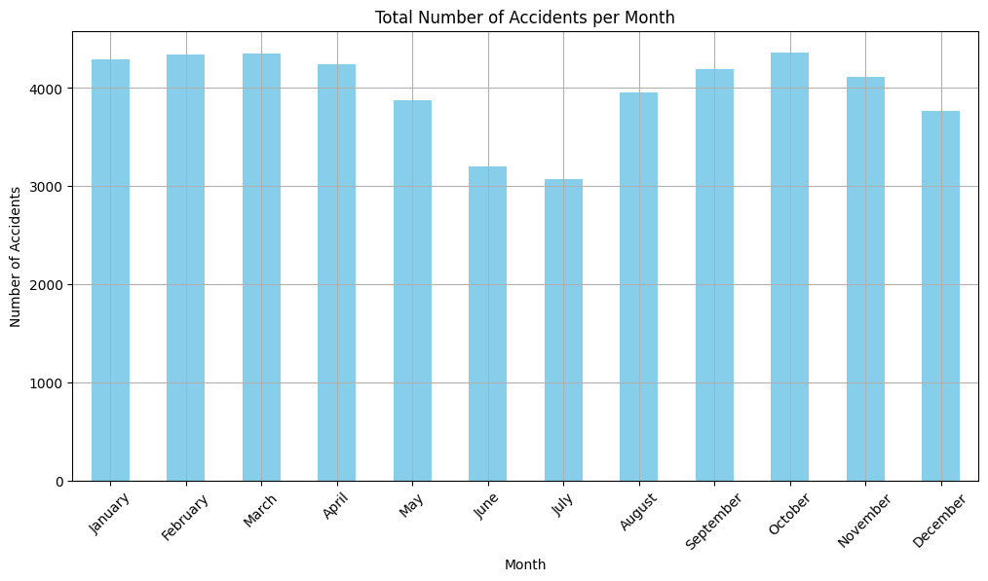
Accidents appear relatively evenly distributed throughout the year, with slight increases in March and October.
The summer months, specifically July and August, show a slight decrease in the number of accidents.
The months of January and December also display a marginally higher frequency of accidents compared to mid-year months.

Slide 19
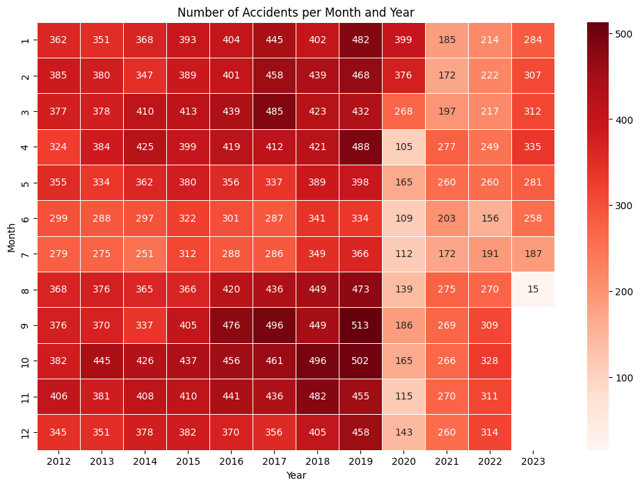
The heatmap indicates that accidents have varied each month over the years, with high frequencies observed in March and October across multiple years.
There is a visible decrease in accidents per month starting from the year 2020 onwards.
The months in the later years, particularly 2022 and 2023, show a significant reduction in accident numbers, with January and February 2023 having notably fewer accidents.

Slide 20
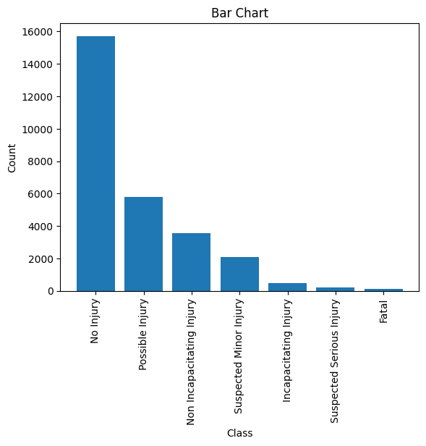
About Target Variable
The bar chart shows that the majority of traffic accidents result in no injury, with this category far exceeding others in count.
Incidents leading to possible injury are the next most common, followed by non-incapacitating injuries and suspected minor injuries.
Fatalities and incapacitating injuries, while present, occur much less frequently than non-fatal outcomes.

Slide 21
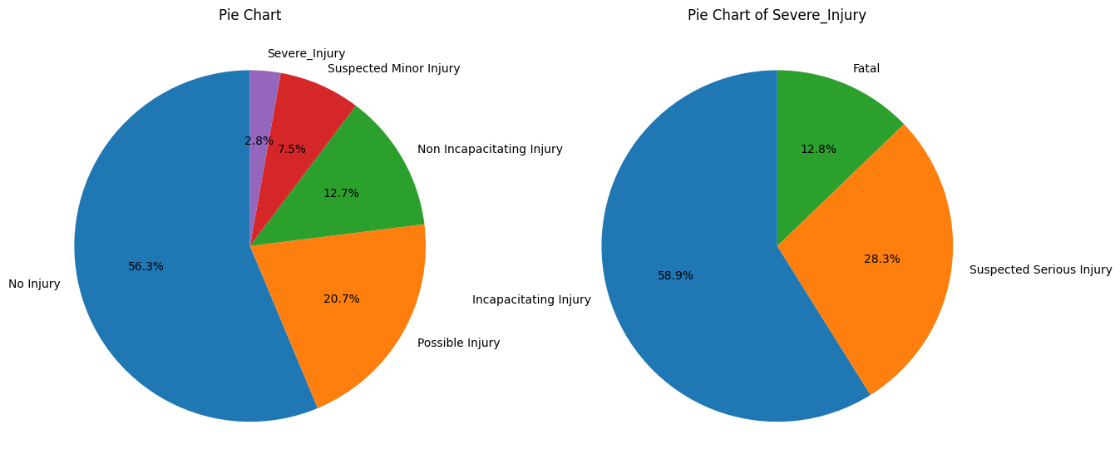

Slide 22
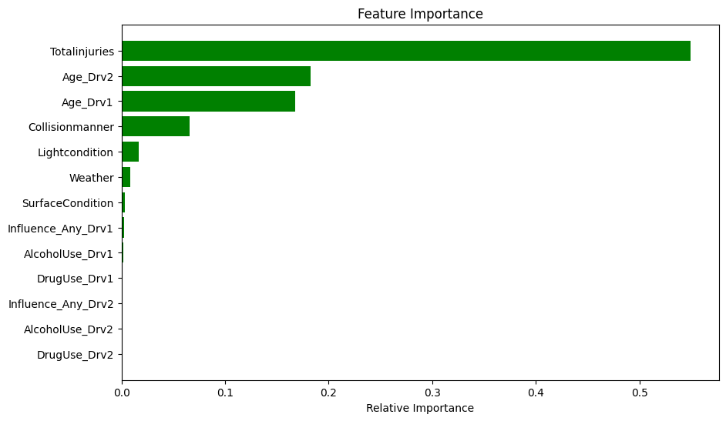
Feature Importance
'Total Injuries' is the most influential feature in predicting accident outcomes, followed by 'Age_Drv2'.
'Age_Drv1', 'Collision Manner', and 'Light Condition' also have notable importance in the model.
'Weather', 'Surface Condition', and various driver influences such as alcohol and drug use show lesser but still relevant influence on predictions.

Slide 23
Machine Learning Models
Logistic Regression
Support Vector Machine
Multinomial Naive Bayes
Decision Trees
Random Forest
Gradient Boost
Stacking classifier

Slide 24
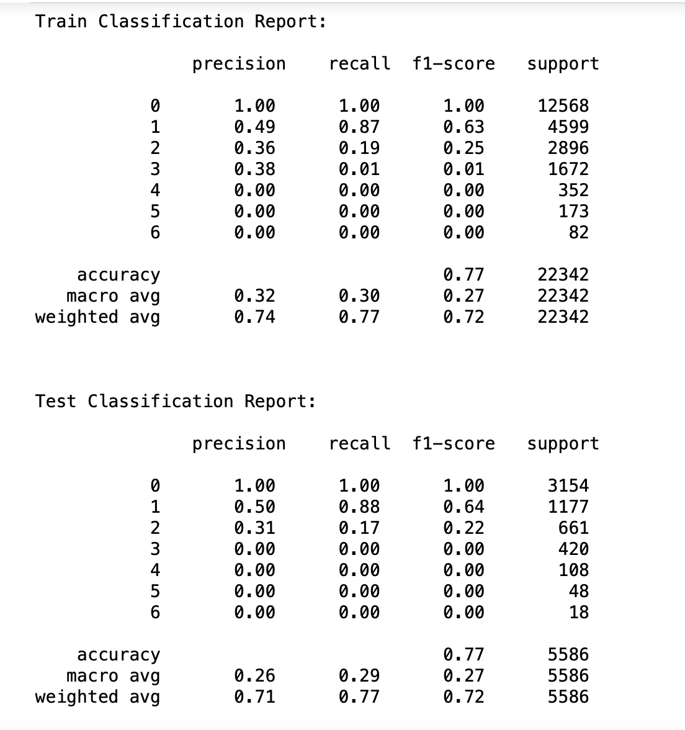
Logistic Regression
We got both train and test accuracy as 77% which indicated there is no overfitting and under-fitting.
As this is an unbalanced classification F1-score plays an important role.
As expected, the classifier is able to perform well on classes that have more data to support, so we got an f1-score as 1.00 for class 0, 0.64 for class 1, and 0.22 for class 2. For the remaining classes, we got 0.00. So, it is unable to classify the classes 3,4,5,6.

Slide 25
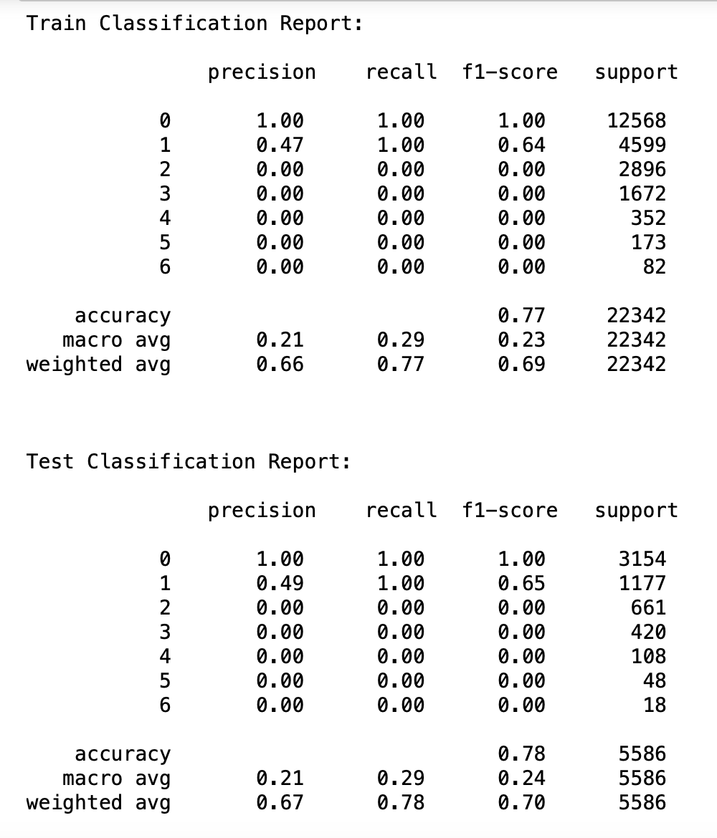
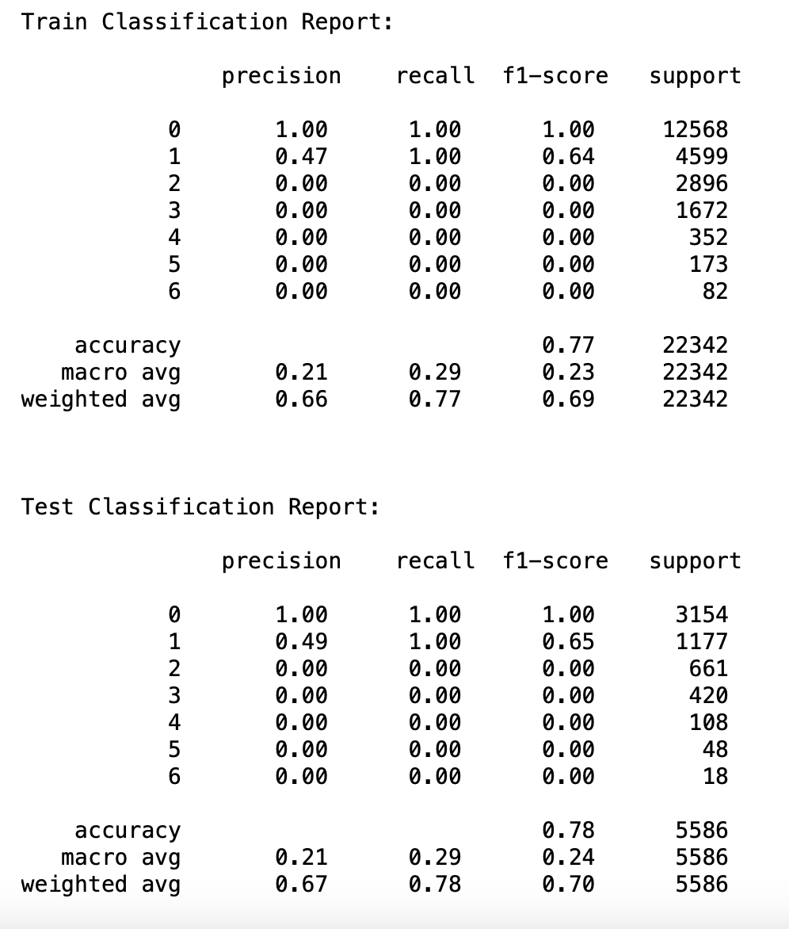
Support Vector Machine
After Hyper parameter tuning

Slide 26
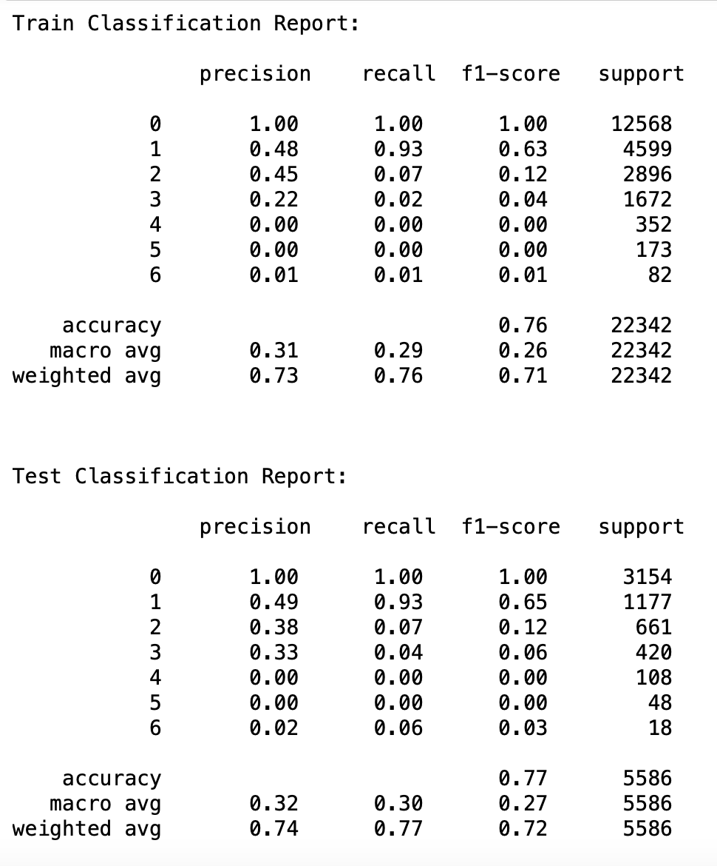
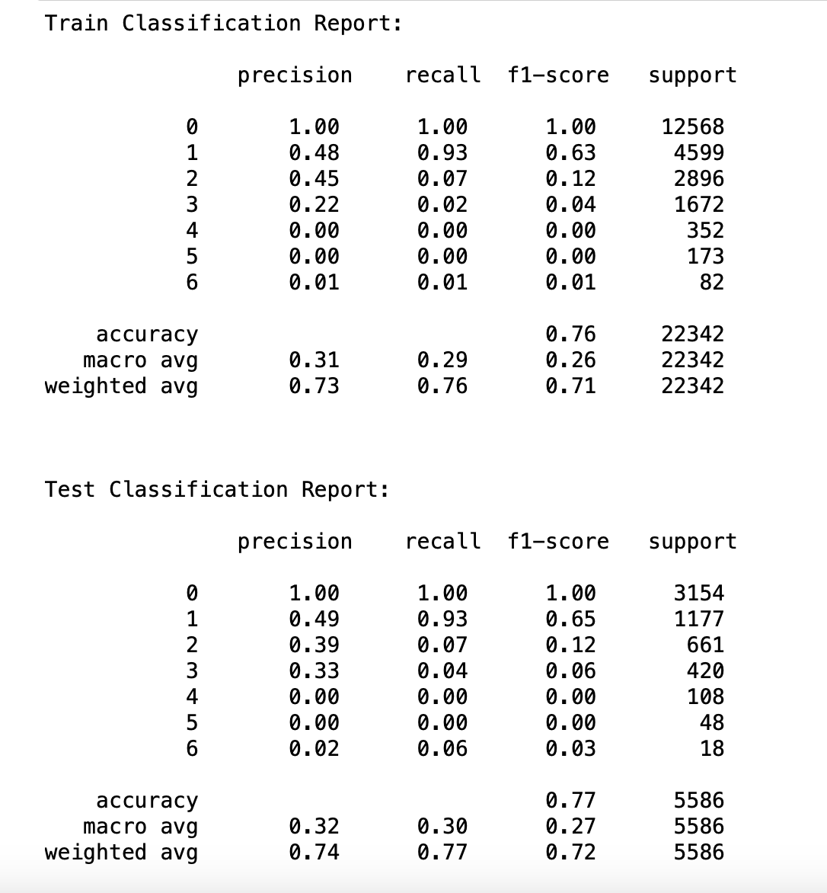
Multinomial Naive Bayes
After Hyper parameter tuning

Slide 27
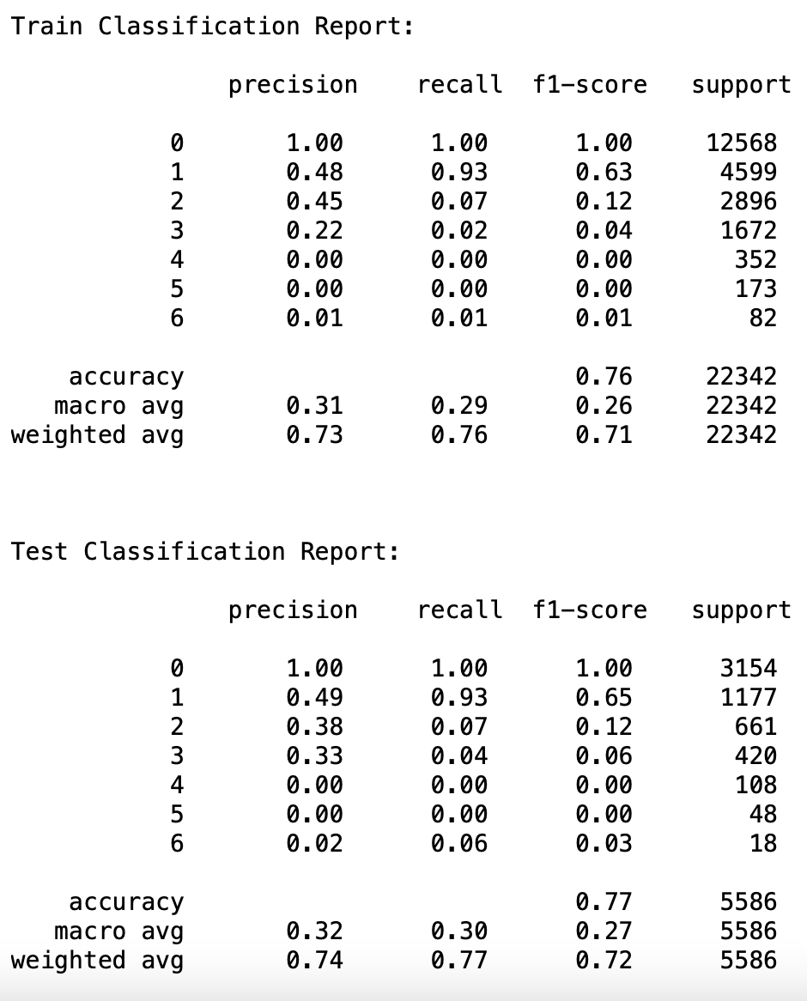
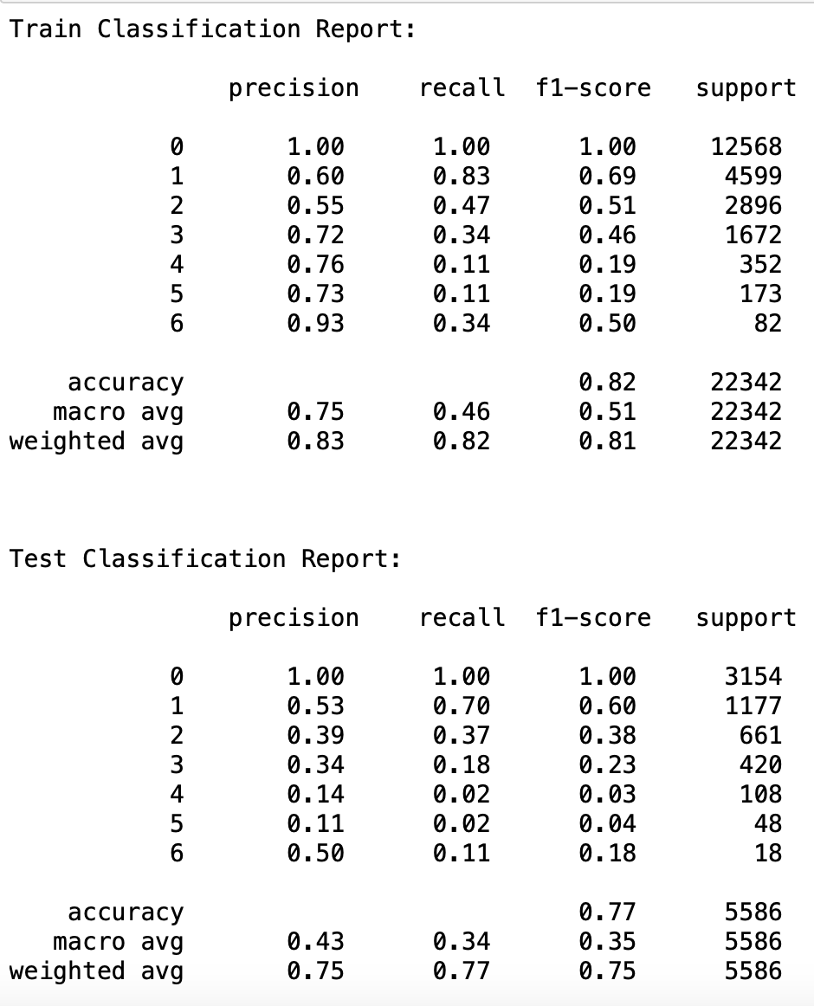
Decision Tree Classifier
After Hyper parameter tuning

Slide 28
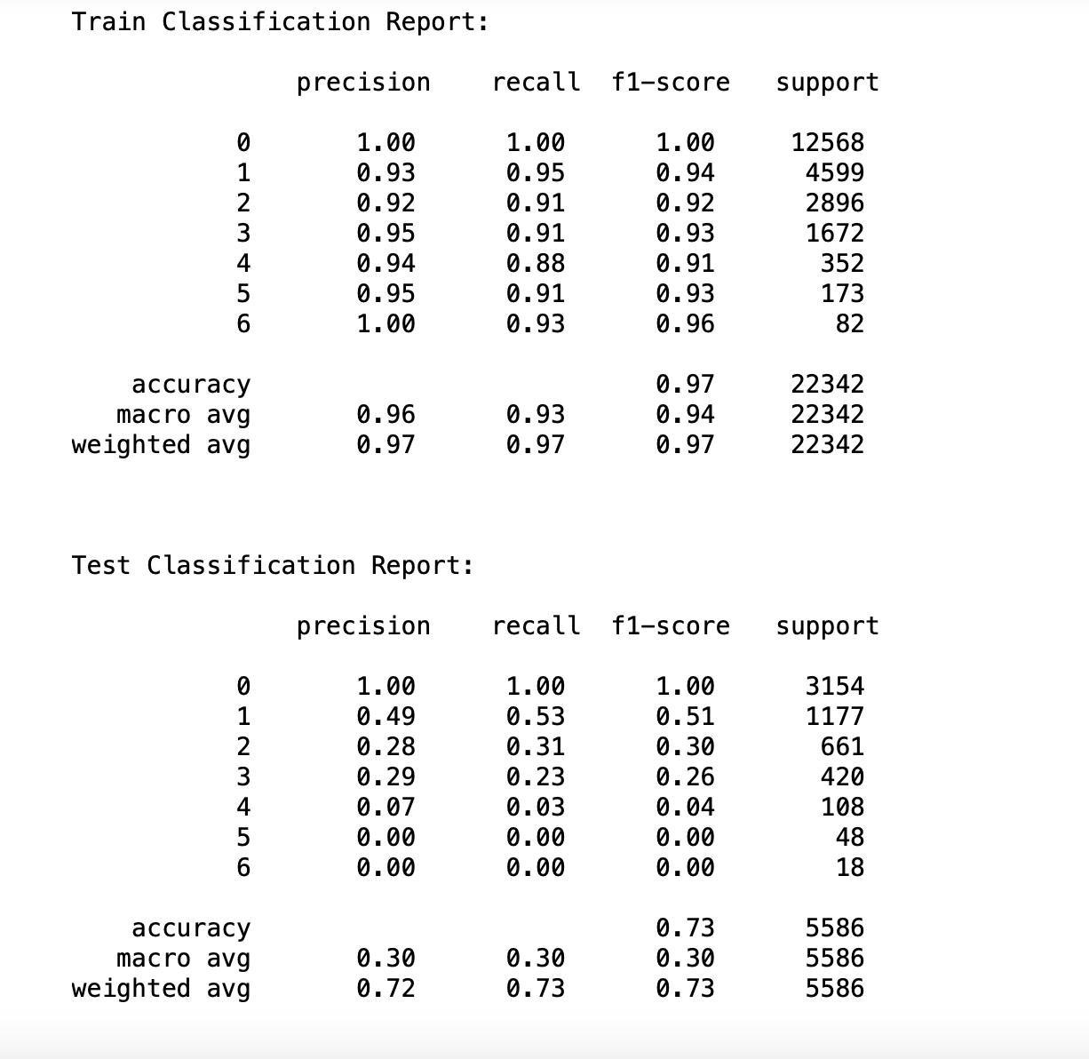
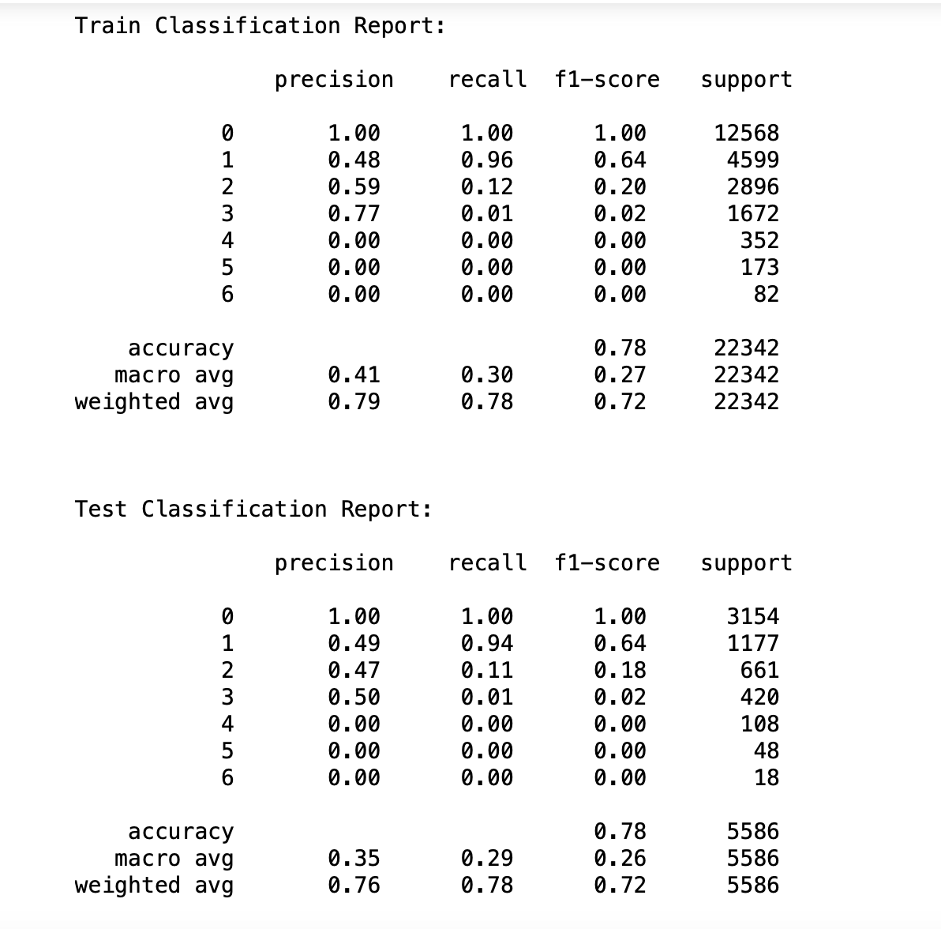
Random Forest Classifier
After Hyper parameter tuning

Slide 29
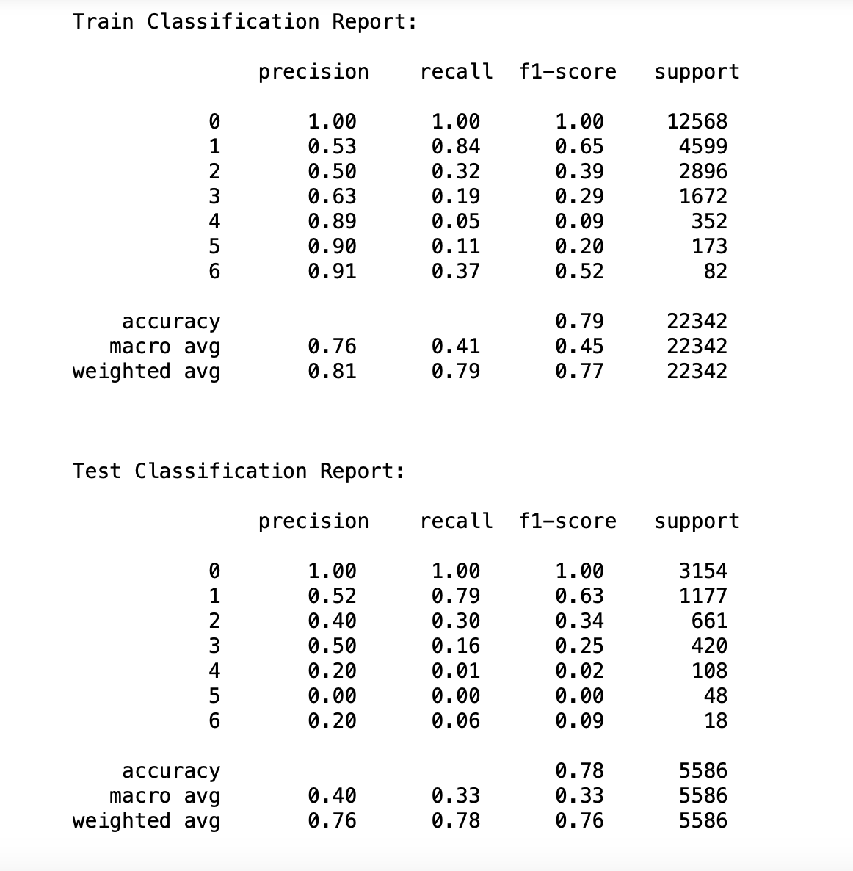
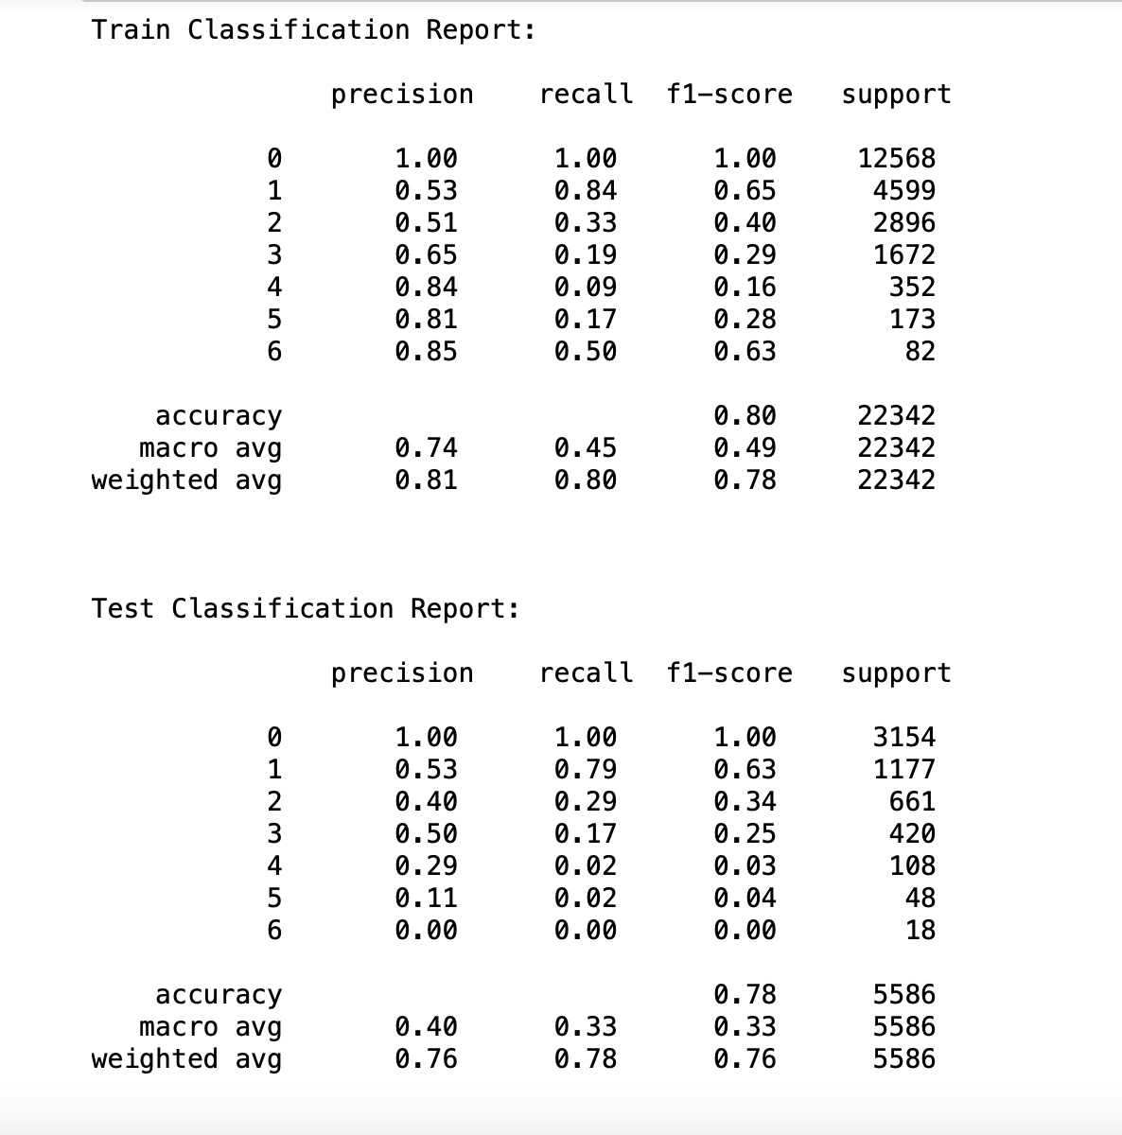
Gradient Boosting Classifier
After Hyper parameter tuning

Slide 30
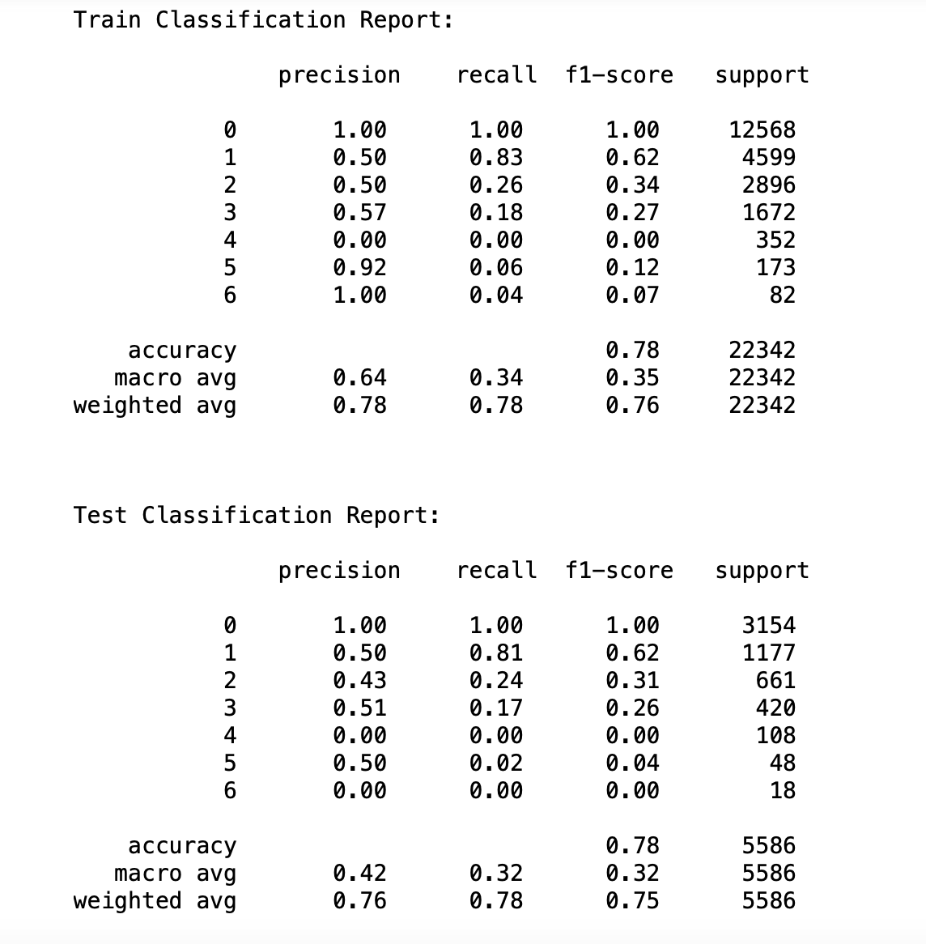
Stacking Classifier
We performed the Stacking classifier by the combination of the Decision Tress classifier, Radom Forest Classifier, and Gradient Boosting Classifier.
Both for train and test data we got 78% accuracy which means no overfitting or underfitting.
As f1-score is an important factor in unbalanced classification, for classes with higher support we got a little better f1-score and for a couple of classes we got 0.00.

Slide 31
Comparison Table
 | Logistic Regression | SVM | Multinomial Naïve Bayes | Decision Tree | Random Forest | Gradient Boosting | Stacking Classifier
0 | 1.00 | 1.00 | 1.00 | 1.00 | 1.00 | 1.00 | 1.00
1 | 0.64 | 0.65 | 0.65 | 0.60 | 0.64 | 0.63 | 0.62
2 | 0.22 | 0.00 | 0.12 | 0.38 | 0.18 | 0.34 | 0.31
3 | 0.00 | 0.00 | 0.06 | 0.23 | 0.02 | 0.25 | 0.26
4 | 0.00 | 0.00 | 0.00 | 0.03 | 0.00 | 0.03 | 0.00
5 | 0.00 | 0.00 | 0.00 | 0.04 | 0.00 | 0.04 | 0.04
6 | 0.00 | 0.00 | 0.03 | 0.18 | 0.00 | 0.00 | 0.00
Accuracy | 0.77 | 0.78 | 0.77 | 0.77 | 0.78 | 0.78 | 0.78

Slide 32
Conclusion
The application of machine learning techniques to historical crash data in Tempe City has provided valuable insights into the predictors of injury severity in traffic accidents.
Total injuries, age of drivers, collision manner, light conditions, and weather were among the most significant features influencing the severity of injuries.
Among the various models tested Decision Trees and Gradient Boosting have shown better results compared to other classification models.
The findings from this study could be instrumental in enhancing traffic safety measures and informing emergency response strategies.
Continual refinement of the models and integration of more granular data can further improve the predictive power and usefulness of the research.

Slide 33
References:
1.08 Crash Data Report (detail) - Catalog. (2023, October 13). https://catalog.data.gov/dataset/1-08-crash-data-report-detail-498c3
DATA 602 Intro to Data Analysis and Machine Learning - Class notes

Slide 34
THANK YOU

